Slide 1

FundThrough Company
Group Members : Sumin Liu
Chihchen Tsai
Dinne lzzle Lu
Md Rafi Al Arabi Bhuiyan
Atif Arham
Class Section : EAC594NBH
Professor : Gail Harris
Figure 1. FundThrough company

Slide 2
Outline - Report Contents
Introduction
Discuss the process for transferring funds
The difference between financial institutions and banks
Client’s Relationship Management
Risk management plan
Conclusion
Recommendations
Reference

Slide 3
Introduction
Entrepreneurship is what young people out of society want to do most, but what they need most is capital. FundThrough is a well-known financial aid company in Canada, and in the following report, we will introduce the operation of this company and how it attracts customers.
Intended Audience – People interested in starting a business
Reporting Objectives – In the report, we analyzed the communication between the company and its customers, how the company helped new customers, and explored the difference between financial companies and banks. To allow new customers to understand the company’s operations more quickly, we also compiled this company—the advantages and disadvantages.
Report Purpose – Through this feasibility report, we propose the maximum benefit of cooperating with this company.
Expected Results – We expect to attract more customers for this company

Slide 4
Process for transferring funds
BDC offers online loans like FundThrough
Eligibility: Canadian-based businesses that have been generating revenues for at least two years. A good credit history is required.
Amount:Up to $100,000
Rate and term: The loan is offered at a floating base rate of 6.05 per cent, plus an additional interest charge ranging between 1 per cent and 12 per cent, depending on the BDC's evaluation of the risk. The term is five years. There is an annual loan-management fee of $150.

Slide 5
Process for transferring funds
Repayment: Business owners can choose to postpone their capital payments in the first six months and pay only interest; after that, the loan is repaid in 60 monthly payments. There are no penalties for early or lump-sum repayments.
Speed: The BDC says the amount of time it takes to complete an application depends on how much information the entrepreneur has on hand. Once the application is complete, processing time varies between one to five business days. Once the BDC authorizes the loan, it usually takes four to 48 hours to receive the money.
“ Klingbeil, C. (2019). Small business borrowing guide: How to find the best loan for your company”.

Slide 6

Merger with Intuit Quickbooks and Freshbooks
The direct integration of FundThrough with QuickBooks had been made seamless. “As an existing user can sign up for Quickbooks and get their funding the very next day”. Users can easily sign up, select invoices and get approved for funding using any of the two financial methods.
FUNDTHROUGH
Figure 2. FUNDTHROUGH ANNOUNCEMENTS PRODUCT NEWS (2020)

Slide 7
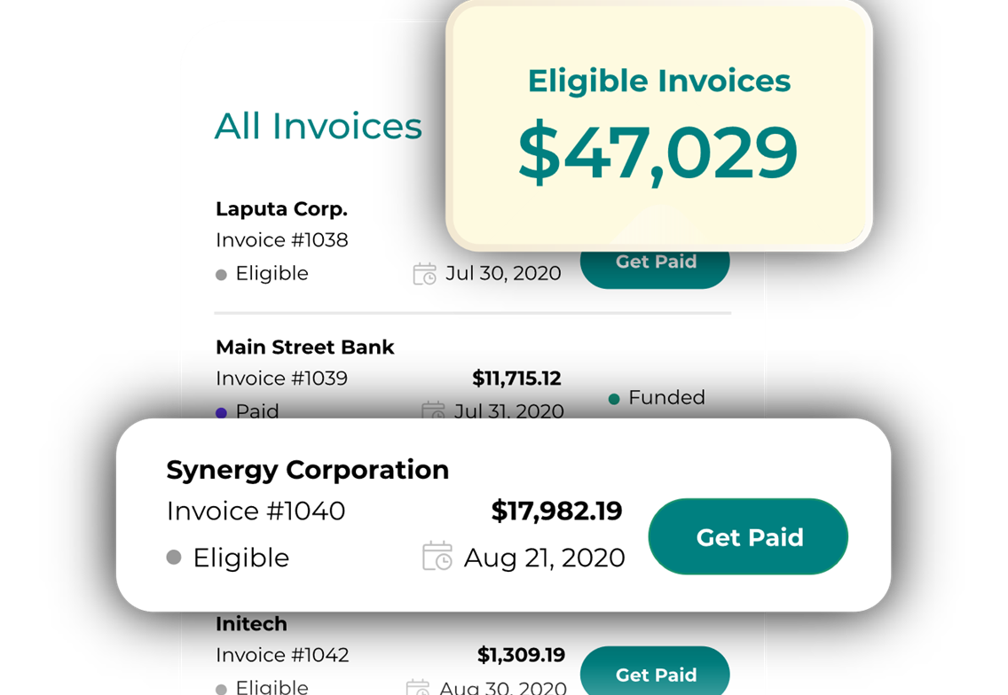
FundThrough has two options when they are processing their loans.
Velocity Invoice Factoring
Express Invoice Financing
Both are great options as it caters to different business. For example:
Velocity processes invoices up to $15 to $10 million and Express processes invoices from $500 to $15000.
Figure 3. FundThrough company

Slide 8
Bank and financial institution-Bank
Banks, like retail or commercial banks is a financial intermediary that acts as a middleman between the supplier of funds and borrowers. The bank's work is to accept deposits and loan the funds to the customers with interest.
The bank's work is to accept deposits and loan the funds to the customers with interest. Bank acts also as a payment agent, which offers payment services. These includes credit and debit cards, direct deposit facilities, cheques and bank drafts.
By investing the deposits in the financial securities and assets and by lending money to clients, bank can make money.
The convenience, safety and interest income are the primary reasons why people use banking.

Slide 9
Financial Institutions
Financial institutions are financing services that provides fund to its members or clients. These are banks and credit unions which are various deposit-taking institutions as well as non-banking institutions like insurance companies, investment funds, brokers and many more
Government regulates most if these institutions. They function by channeling the funds between lenders and borrowers indirectly

Slide 10
Main difference
Non- banking institutions cannot accept deposits into savings and demand deposit accounts which in a banking financial institution’s core business.
But they offer a variety of other services. Here are examples, underwriting of debt and share issues, corporate advisory, securities trading and derivative transactions and other investment services are offered by investment banks. An insurance premium which protects your business against specific losses are services offered by insurance companies.

Slide 11
Advantage and Disadvantage
 | Bank | Financial Institution
Advantage | Convenient Safe Interest income Financial technology More Branches and ATM | Capital loans and risk are available New companies can easily get funding
Disadvantage | High interest rates More and higher fees Slow interest growth | They follow rigid rules for granting loans Many restrictions press on the borrowing company

Slide 12
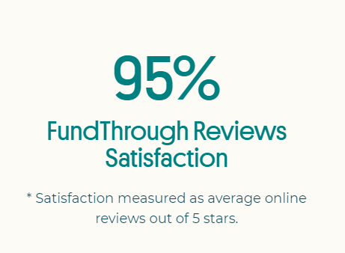

Clients Communication
Our company has a very good client communication since customer satisfaction is our main priority. Following that, we have maintained 95% client satisfaction ratio which is the highest satisfaction rate in the industry.
Our company believes that diversity will help them to provide better service to their clients, which is why its employees are fluent in many languages and cultures, allowing them to gain a better understanding of their clients' problems.

Slide 13
Quick Funding: Clients can open a free account with us, which is a very simple sign-up and as secure as your bank account with no obligations. Clients can also expect to get their funds based on their preferred invoices within 24 hours.
Pricing Transparency: Clients can get an idea of the expected price, which can only be changed if the individual decides to fund.
Flexibility in funding: Funding for your business is entirely dependent on client invoices, which means that the more your company's sales grow, the more funding capacity will be supplied.
Assistance and Recommendations: the company not only raises your funds but also assists business owners by providing strategies on how to grow, as there is a team working behind to deliver a better service.
Customer Service:

Slide 14
How FundThrough maintains its clients' relationships
Great Customer Service
Provides simple cash flow management
Employees who are concerned in their client’s success
New funding innovations and improvements to business strategies
Diversity plays a significant role

Slide 15

Risk management plan
Operation Risk
Figure 4. Kim Harrison (2020)
1
In risk management, most of the operating risks of financing companies are the reasons for the operation of the company, which leads to very unstable future profits. This is one of the important factors for the financing company to affect the optimal capital structure of the company, and this is also the customer's choice of financing company the risks that must be considered and assumed.
On the contrary, banks have relatively low risks in this respect. If banks focus on obtaining funds through low-risk methods, it is also a threat to financing companies. Financing companies usually have greater incentives or better systems to monitor lenders to reduce credit risk after lending due to higher risks, or they can have greater flexibility or greater flexibility in the event of problems.

Slide 16
Risk management plan
Market Risk
Figure 4. Kim Harrison (2020)
2
The second risk is that the financing company does not absorb deposits and does not have the bank's currency creation function, resulting in lower social costs. If the financing company filed for bankruptcy, it may have a short-term impact on the financial market. However, because banks cannot possibly go bankrupt, certain companies or individuals with higher risks cannot obtain the necessary funds through bank loans, so there is still room for the establishment of financing companies.

Slide 17

Conclusion
Provide comprehensive services to ensure that companies can always obtain working capital on their own terms and under legal circumstances.
Help customers obtain funds in the shortest possible time. Obtaining funds in their own way is different from the bank’s excessive paperwork that takes too long.
New companies can easily get funding.

Slide 18
Conclusion
Fast financing-to be eligible for next-day payment of unpaid invoices.
Price transparency-customers can choose the charging plan that suits their own situation.
Flexible funding options-The customer's choice of funds will increase with business sales.
The more invoices, the more funds available.

Slide 19
Recommendations
Use invoice funds to help customers.
The highest satisfaction survey in the industry, Increase the confidence of customsers.
Companies can easily obtain funds by using invoices as collateral.
Provide customers with different traditional model from the past.
Suitable for customers who need to issue invoices with their own business.

Slide 20
Recommendations
Provide solutions for customer classification under strict loan rules.
Many restrictions, employees should be improve with necessary training to provide customers with good services and avoid unnecessary conflicts.

Slide 21
Reference
Company - we're entrepreneurs. FundThrough. (n.d.). https://www.fundthrough.com/company/.
Small business borrowing guide: How to find the best loan for your company - ProQuest (senecacollege.ca)
Startup scores $24.6M in financing - ProQuest (senecacollege.ca)
Industries that use invoice factoring AND FINANCING: FUNDTHROUGH. FundThrough. (n.d.). https://www.fundthrough.com/industries/.
QuickBooks app Store. (n.d.). https://quickbooks.intuit.com/app/apps/appdetails/fundthrough/.
Read Customer Reviews. FundThrough. (n.d.). https://www.fundthrough.com/customer-reviews/.
senecacollege.primo.exlibrisgroup.com. (n.d.). https://senecacollege.primo.exlibrisgroup.com/permalink/01SENC_INST/1g8f6u9/cdi_proquest_miscellaneous_2383335937.
senecacollege.primo.exlibrisgroup.com. (n.d.). https://senecacollege.primo.exlibrisgroup.com/permalink/01SENC_INST/1g8f6u9/cdi_proquest_newspapers_1796115685.
senecacollege.primo.exlibrisgroup.com. (n.d.). https://senecacollege.primo.exlibrisgroup.com/permalink/01SENC_INST/1g8f6u9/cdi_proquest_newspapers_2057812306.

